Slide 1
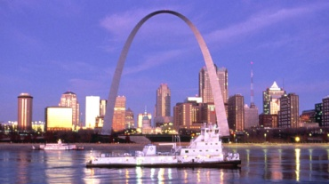
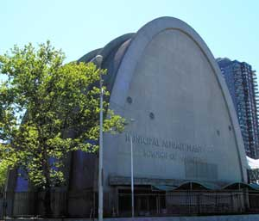
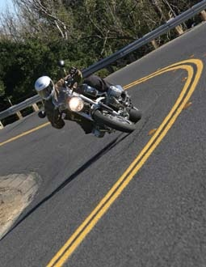
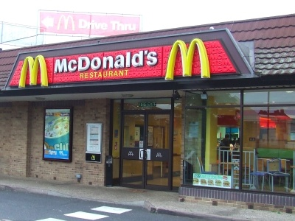
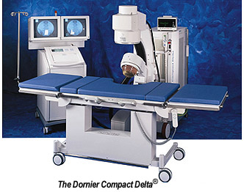
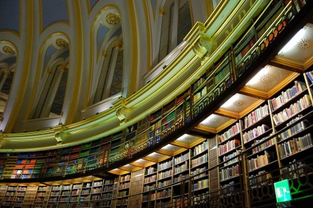
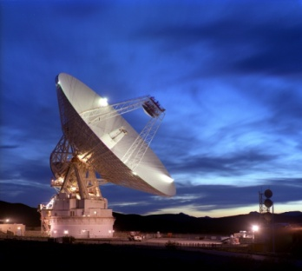
Which among the following shows an application of ellipse?
1
2
3
4

Slide 2
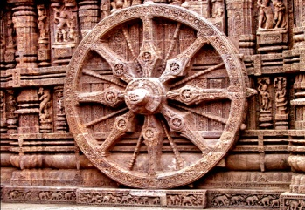
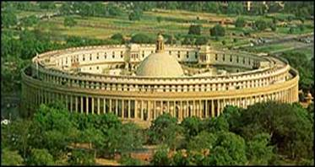
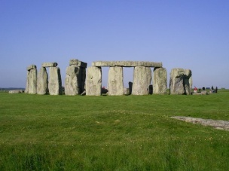
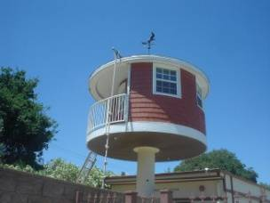
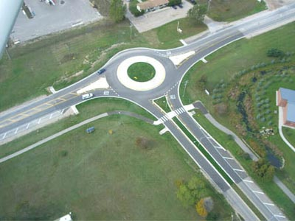
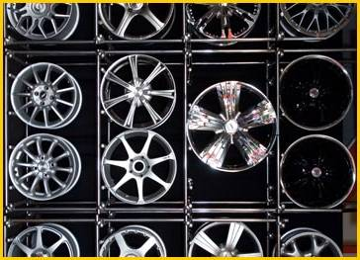
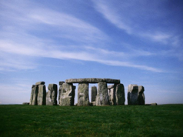
Which among the following is a circle with centre at
origin ?
(x + 3)² + (y –2)² = 16
(x + 4)² + (y + 5)² = 49
x²+ y² = 1.5
x² + y² + 5x +4y= 49

Slide 3
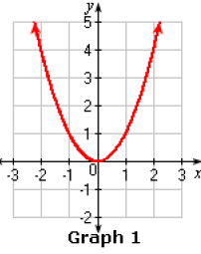
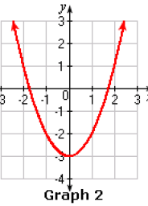
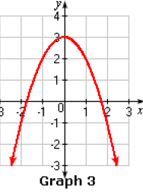
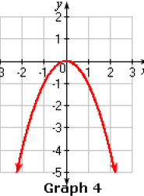
Which is the graph of the parabola y = x² – 3

Slide 4
The centre of the circle (x + 5)² + (y – 3)² = 36
is a point on the line 2x+ 3y+1=0

Slide 5
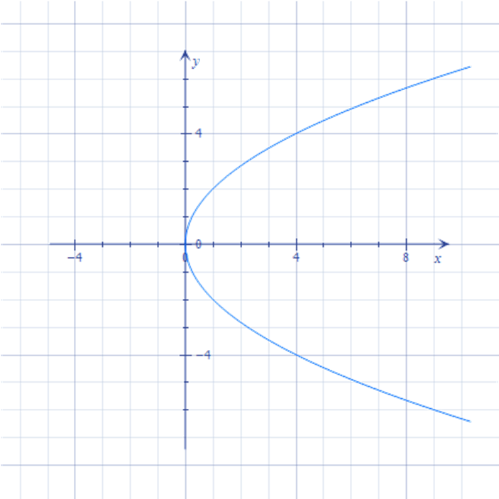
Draw the directrix of the following parabola
$$y^{2}=4x$$

Slide 6
The equation of the circle with centre (0,2) and radius 2
x²+ y² = 2
x²+ (y-2)² = 2
(x-2)²+ (y-2)² = 2
x²+ (y-2)² = 4

Slide 7
Match the following!
y² = 12x
Directrix is y=-2
x² = 8y
Opens to the left
y² =- 12x
Latus rectum is 6
y² = 6x
Focus ( 0,3)

Slide 8
Match the following! Answer
y² = 12x
Directrix is y=-2
x² = 8y
Opens to the left
y² =- 12x
Latus rectum is 6
y² = 6x
Focus ( 0,3)

Slide 9
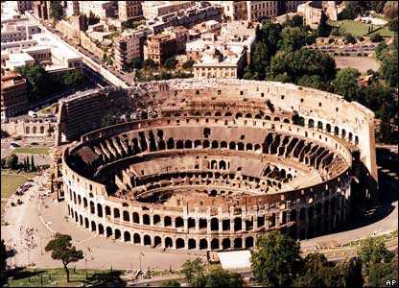
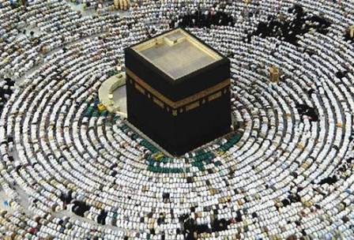
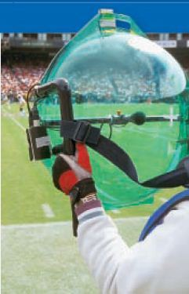
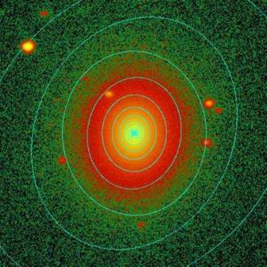
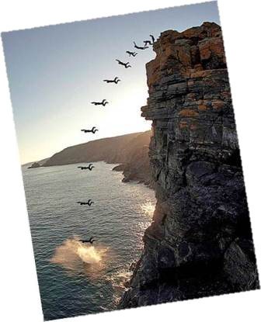
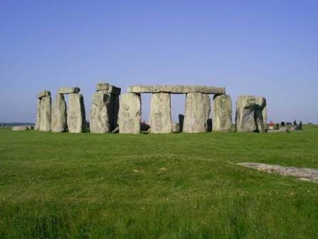
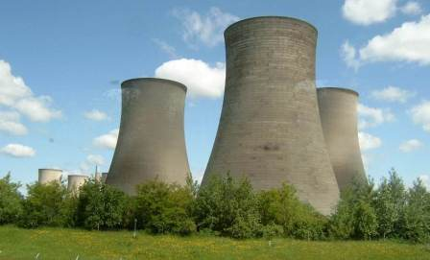
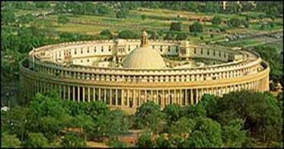
Circle the applications of Parabola in red, Ellipse in
Green , hyperbola in yellow and circle in pink

Slide 10
The point (–2.5, 3.5) lie inside the circle x² + y² = 25

Slide 11
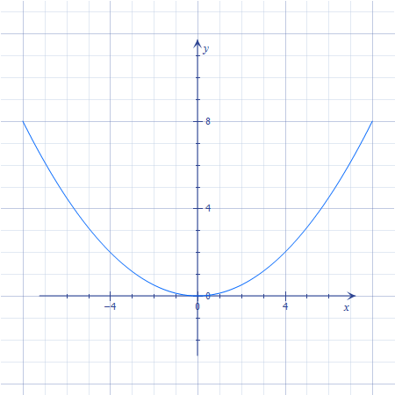
Mark the focus of the following parabola
$$x^{2}=8y$$

Slide 12
Find the equation of the parabola that satisfies the conditions :Focus (0,–3); directrix y = 3
y² = 12x
y² = -12x
x² = 12y
x² = 12y

Slide 13
Did you like
Mouse Mischief Quizzing?

