Slide 1
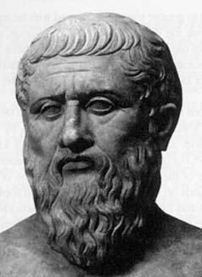
“The knowledge of which geometry aims is the knowledge of the eternal.”
PLATO
Maker of mathematicians

Slide 2
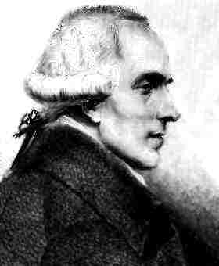
“What we know is not much What we do not know is immense.”
PIERRE-SIMON LAPLACE

Slide 3
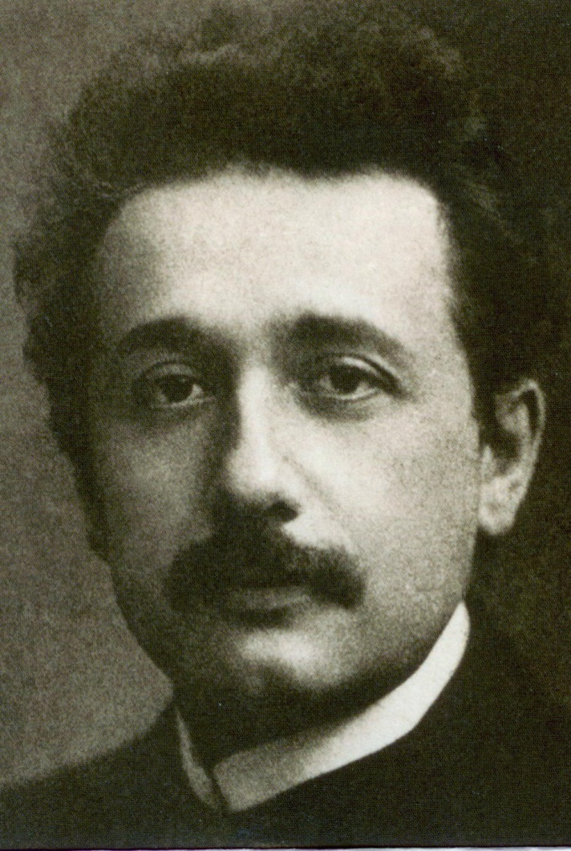
“Imagination is more important than knowledge.”
Albert Einstein

Slide 4
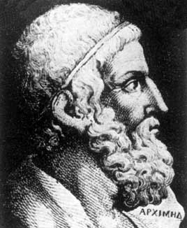
“Give me a place to stand and I will move the earth.”
Archimedes

Slide 5
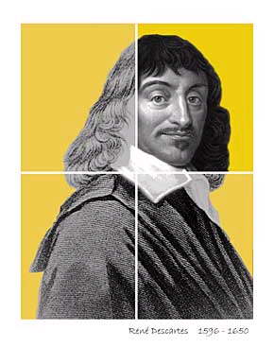
“Perfect numbers like perfect men are very rare.”
René Descartes

Slide 6
“There is no royal road to geometry”
Euclid
Father of geometry

Slide 7
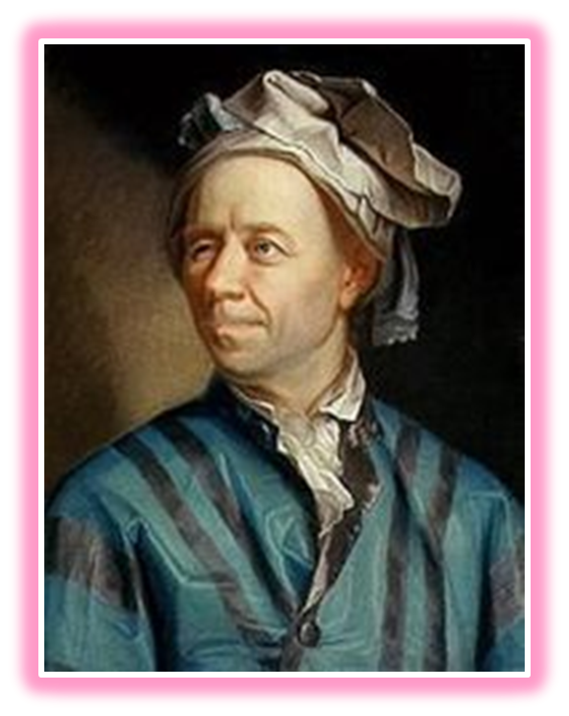
[upon losing the use of his right eye] “Now I will have less distraction. “
Leonhard Euler

Slide 8
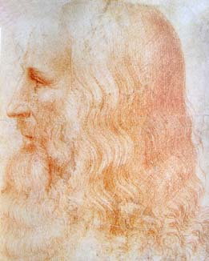
“He who loves practice without theory is
like the sailor who boards ship
without a rudder and compass
and never knows
where he may cast.”
Leonardo da Vinci

Slide 9
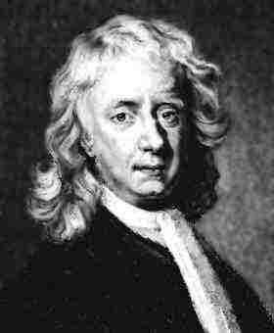
“God created everything by number,
weight and measure.”
Isaac Newton

Slide 10
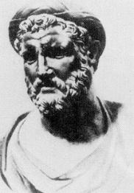
“Time is the soul of this world.”
Pythagoras

Slide 11
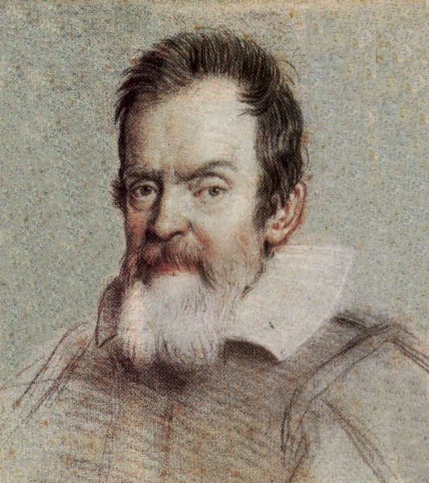
“The book of nature is written in the language of Mathematics”
Galileo

Slide 12
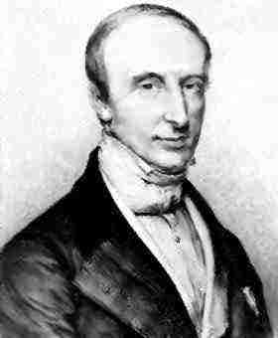
“Men pass away, but their deeds abide.......”
-Augustin-Louis Cauchy

Slide 13
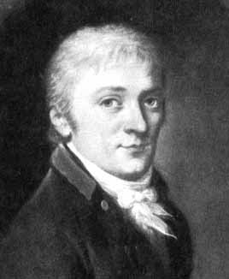
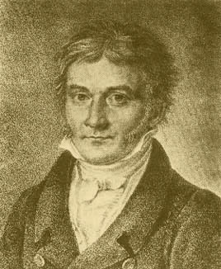
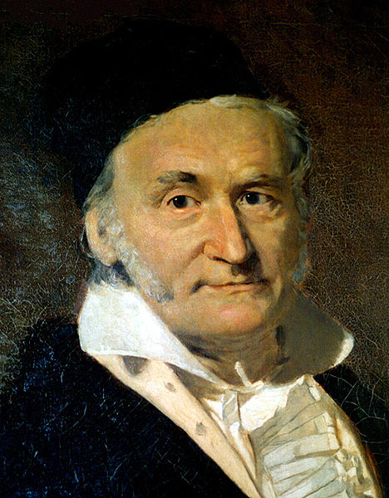
-C . F Gauss
The prince of Mathematics

Slide 14
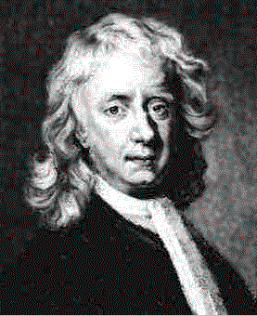
Isaac Newton Dec 25 1642 - March 20 1727 Born: Lincolnshire, England. Died: Kensington, London

Slide 15
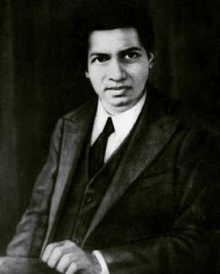
Srinivasa Ramanujan December 22, 1887 – April 26, 1920 Born: Madras, India Died: Bangalore, India.

Slide 16
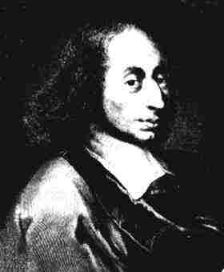
Blaise Pascal June 19 1623 - Aug 19 1662 Born: Clermont - Ferrand, France. Died: Paris, France.
Who invented the
digital calculator
in 1642
At the age of 12.
He discovered that
the sum of the angles
of a triangle is 2 right
angles

Slide 17
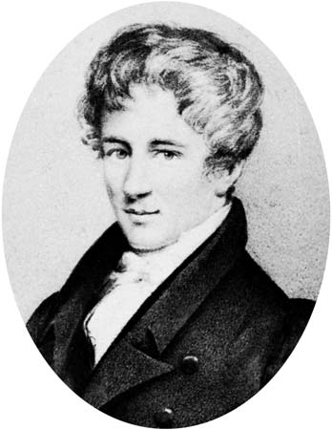
He has left mathematicians something to
keep them busy for hundred years.
-Charles Hermit about Niels Henrik Abel
Niels Abel.

Slide 18
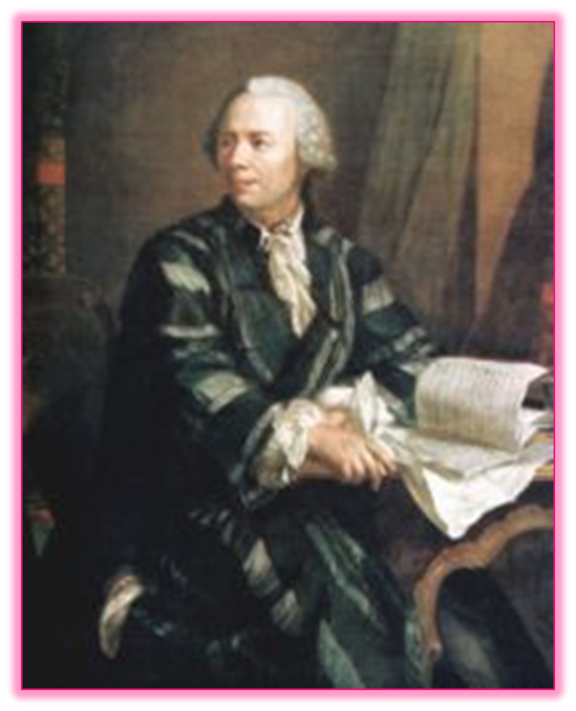
"Read Euler, read Euler, he is a master for us all".
Pierre-Simon Laplace

Slide 19
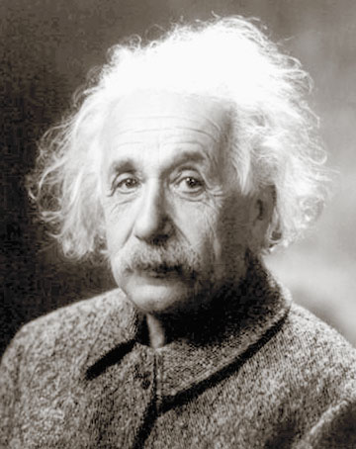
Albert Einstein
March 14 1879 –
April 18 1955
Born Ulm, Germany.
Died Princeton, USA.
Notes:
Einstein contributed more than any other scientist to the modern vision of physical reality. His theory of relativity is held as human thought of the highest quality.
In 1894 Einstein's family moved to Milan and Einstein decided officially to relinquish his German citizenship in favour of Swiss. In 1895 Einstein failed an examination that would have allowed him to study for a diploma as an electrical engineer at Zurich. After attending secondary school at Aarau, Einstein returned (1896) to the Zurich Polytechnic, graduating (1900) as a secondary school teacher of mathematics and physics.

Slide 20
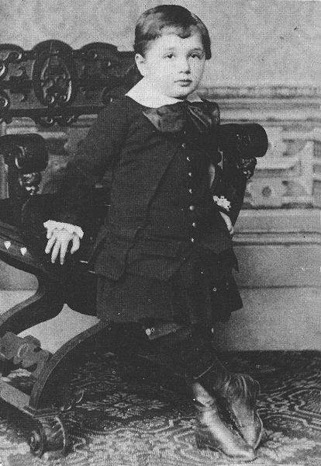
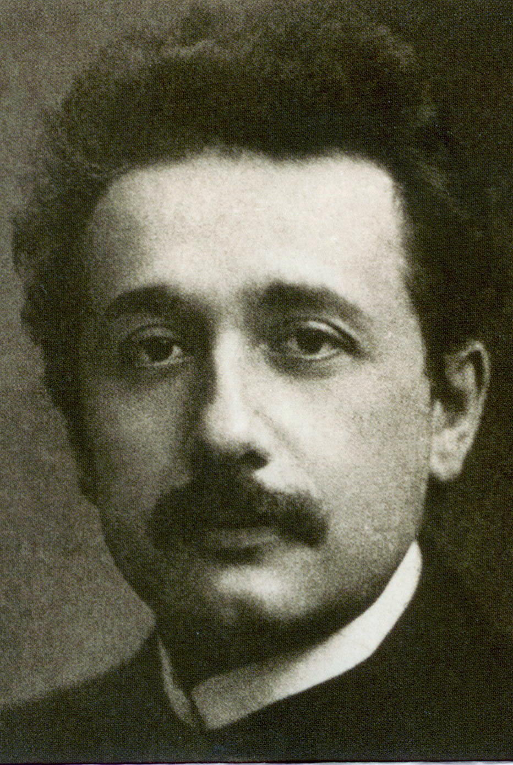
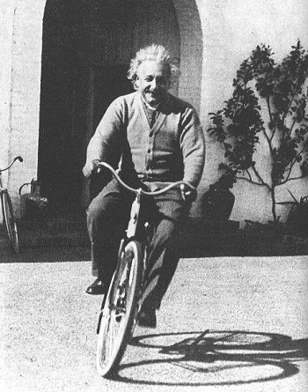

Slide 21
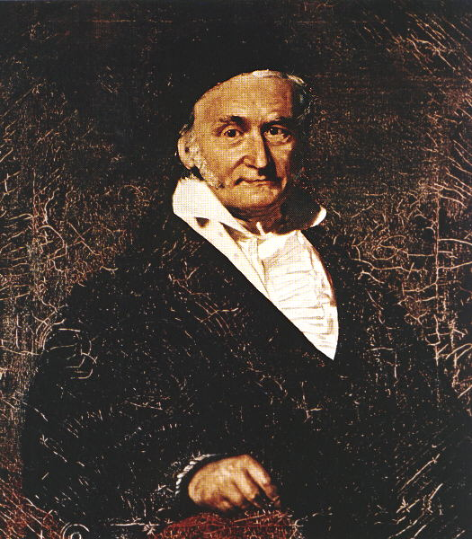
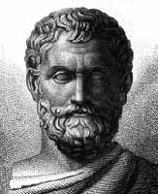
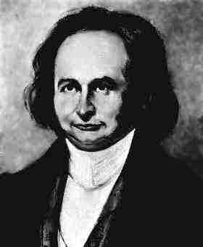
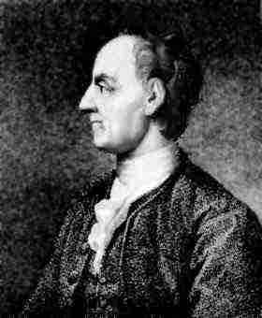
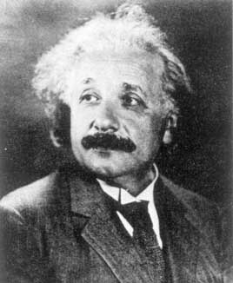
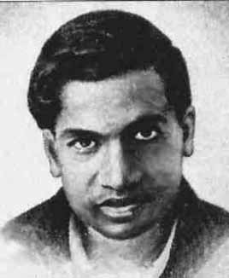
WE SALUTE YOU
LAPLACE
JACOBI

